Slide 1
Objectives
Understand the role of the CPU and the fetch-execute cycle
Understand the following registers in the Von Neumann architecture:
MAR (Memory Address Register) • MDR (Memory Data Register)
CIR (Current Instruction Register) • Program Counter (PC)
Accumulator (ACC)
Understand common CPU components including:
ALU (Arithmetic Logic Unit) • CU (Control Unit)
Registers

Slide 2

Starter
A laptop and smartphone are both examples of computer systems
What are the input and output devices for these computer systems?
What component carries out the processing of the instructions?

Slide 3
Starter
Input devices:
Laptop: keyboard, buttons, trackpad, microphone
Smartphone: microphone, buttons, GPS sensor, gyroscopic sensor, touch part of the touchscreen
Output devices:
Laptop and smartphone: speakers, display
Processing:
CPU (Central Processing Unit)

Slide 4
The main components of a computer
MAIN MEMORY
INPUT
DEVICES
CENTRAL PROCESSING
UNIT (CPU)
OUTPUT
DEVICES
SECONDARY
STORAGE

Slide 5
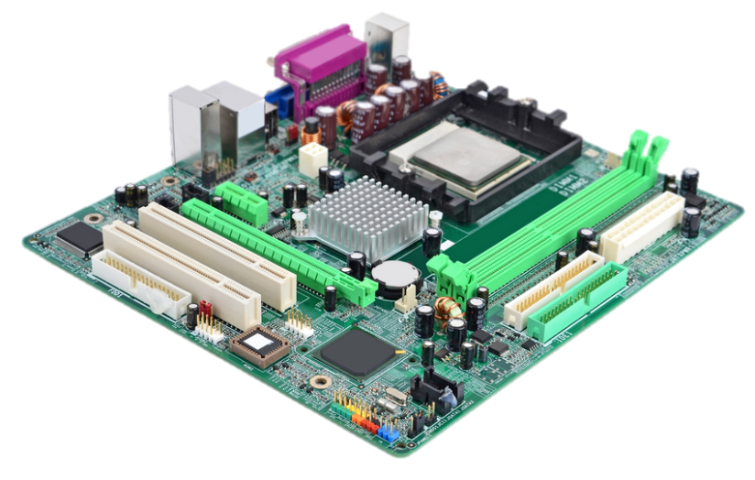
What is this?

Slide 6
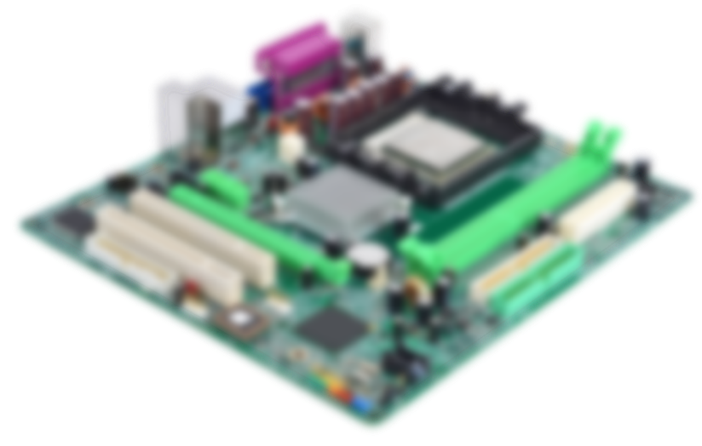
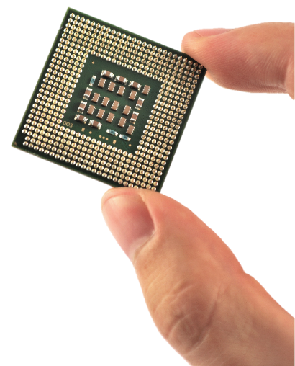
The CPU

Slide 7
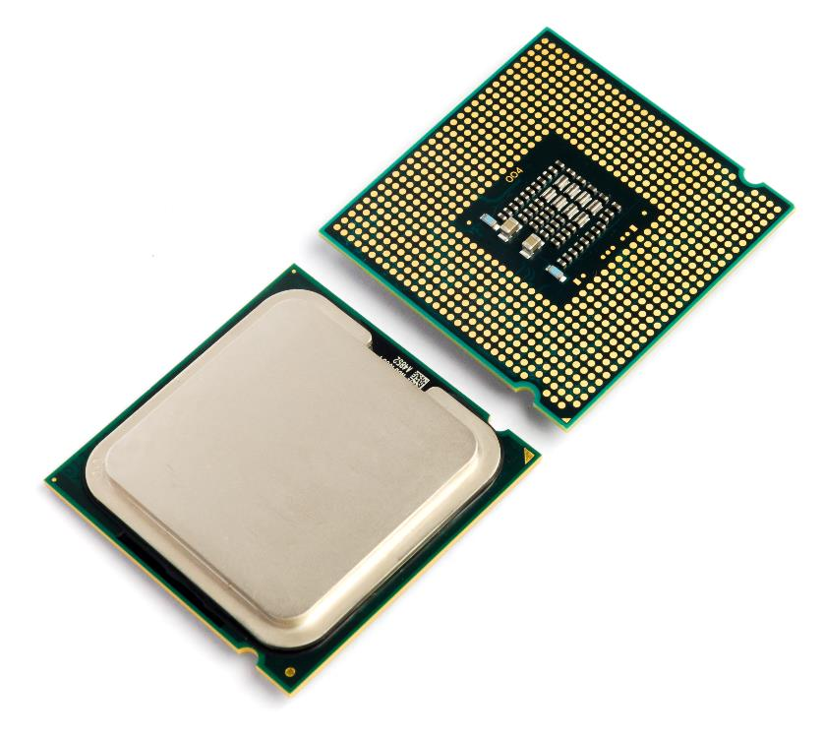
Central Processing Unit (CPU)
The Central Processing Unit or CPU is arguably the most important component of a computer
What does it do?
What organ in the human body is it often compared to?
What are the similarities it has to this organ?

Slide 8


The purpose of the CPU
The CPU processes instructions
When you run a program, it is the CPU which processes the instructions and data that are input
The results are then output
It is often thought of as being the ‘brains’ of the computer
The way that a brain works is very different to a CPU
A CPU simply runs one simple instruction at a time, but billions of instructions are carried out each second

Slide 9
Stored program concept
Before about 1943, early computers stored the data to be worked on in memory
The program was not stored
Instructions were input one at a time using switches, or read in punch cards and executed one at a time
In 1943-44, mathematician von Neumann and his colleagues had the idea of storing the program instructions as well as the data in memory
The stored-program computer was born!

Slide 10
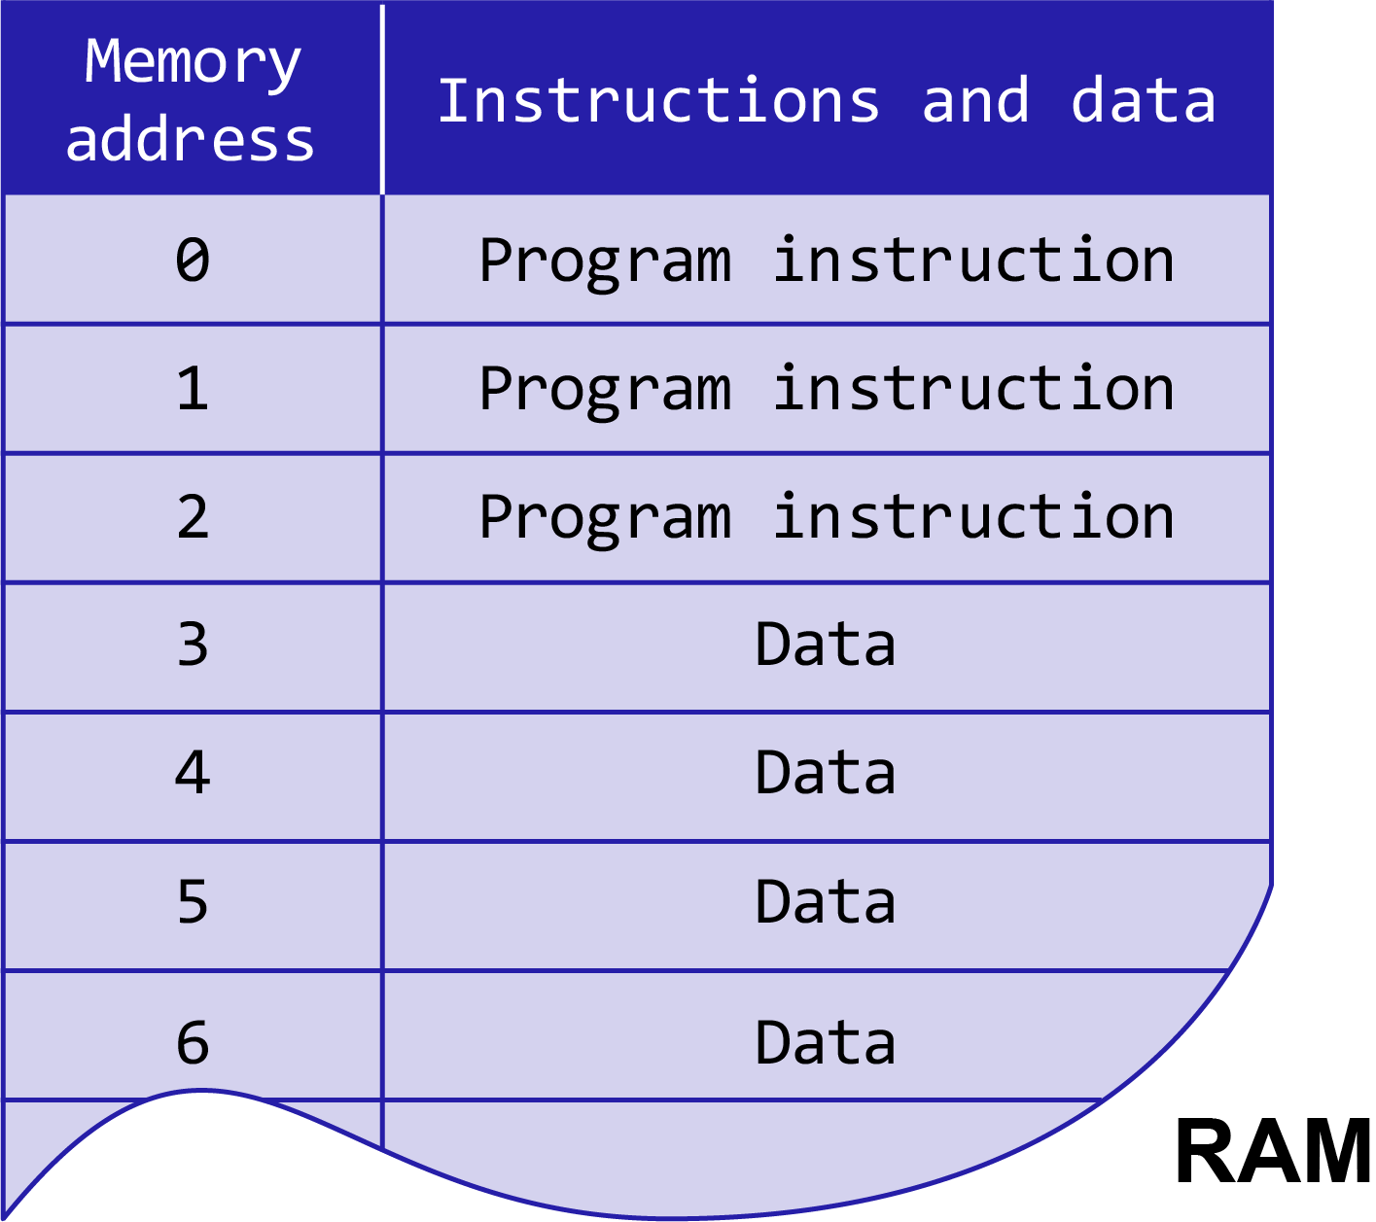
Von Neumann architecture
Program instructions and the data the programs are using are both stored in the same memory
The CPU accesses both instructions and data from the same RAM

Slide 11
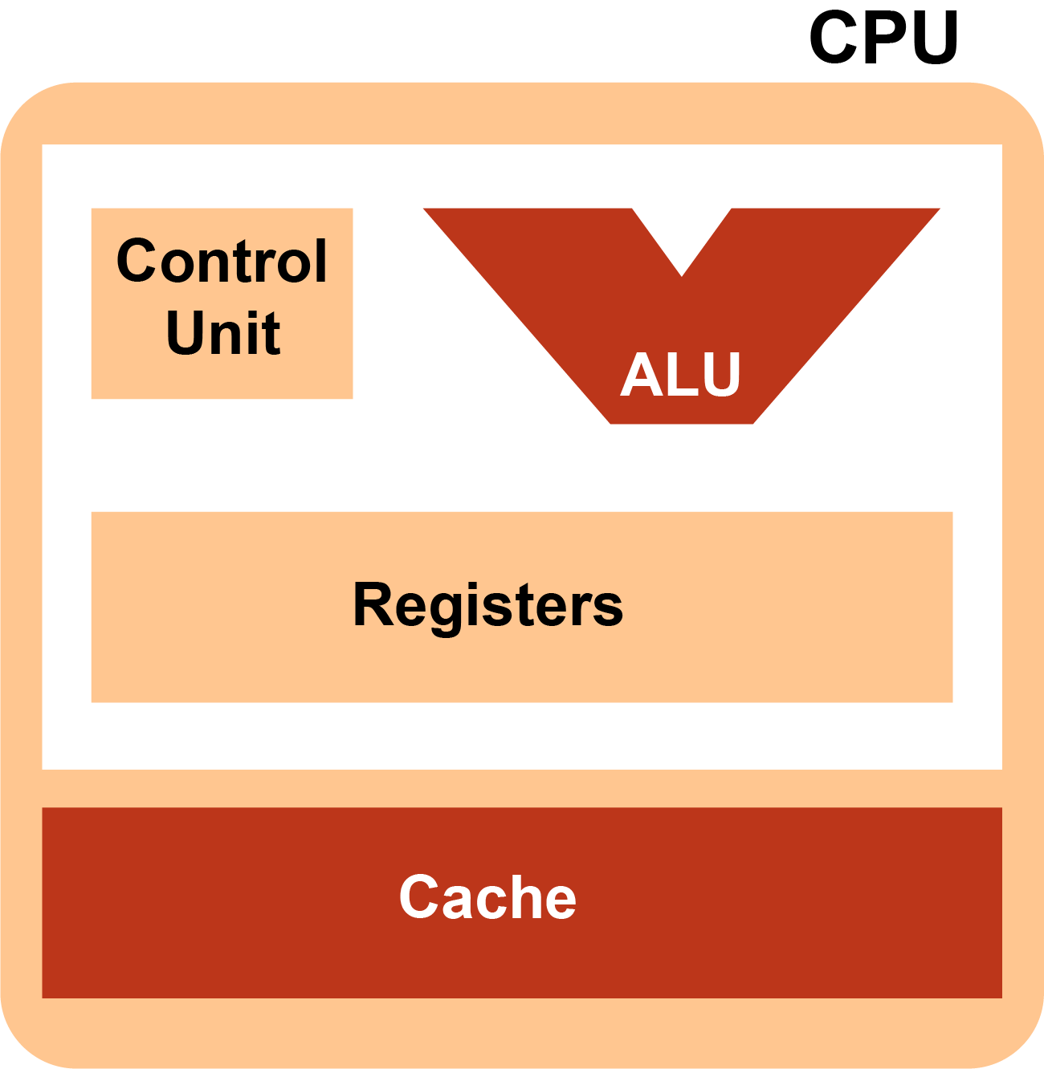
Components of the CPU
The CPU has two major components called the
Control Unit
Arithmetic-Logic Unit (ALU)
There are also registers that are used to carry out these operations
A register is a very fast memory location in the CPU itself
Cache is located on the CPU – it is slower to access than registers but faster than RAM

Slide 12
Registers in the CPU
Program Counter (PC) holds the address of the next instruction to be executed
Memory Address Register (MAR) holds the memory address of the current instruction, and then the data that it uses, so that these can be fetched from memory
Memory Data Register (MDR) holds the actual instruction, and then the data that has been fetched from memory
Current Instruction Register (CIR) holds the instruction currently being executed or decoded
Accumulator (ACC) holds the result of an instruction before it is transferred to memory

Slide 13

Control Unit
The control unit coordinates and controls all of the activities taking place within the CPU
It decodes instructions and executes them
It receives signals from the system clock
It directs the timing and control of other parts of the CPU, much like the conductor of an orchestra

Slide 14
The Arithmetic Logic Unit
The ALU or Arithmetic Logic Unit is where the actual arithmetic operations are done
It also carries out logical operations such as those including AND, OR and NOT
ALU
Accumulator
8
Main Memory
X = 3
Y = 5
ADD X, Y

Slide 15
Worksheet 1
Complete Task 1 on Worksheet 1

Slide 16
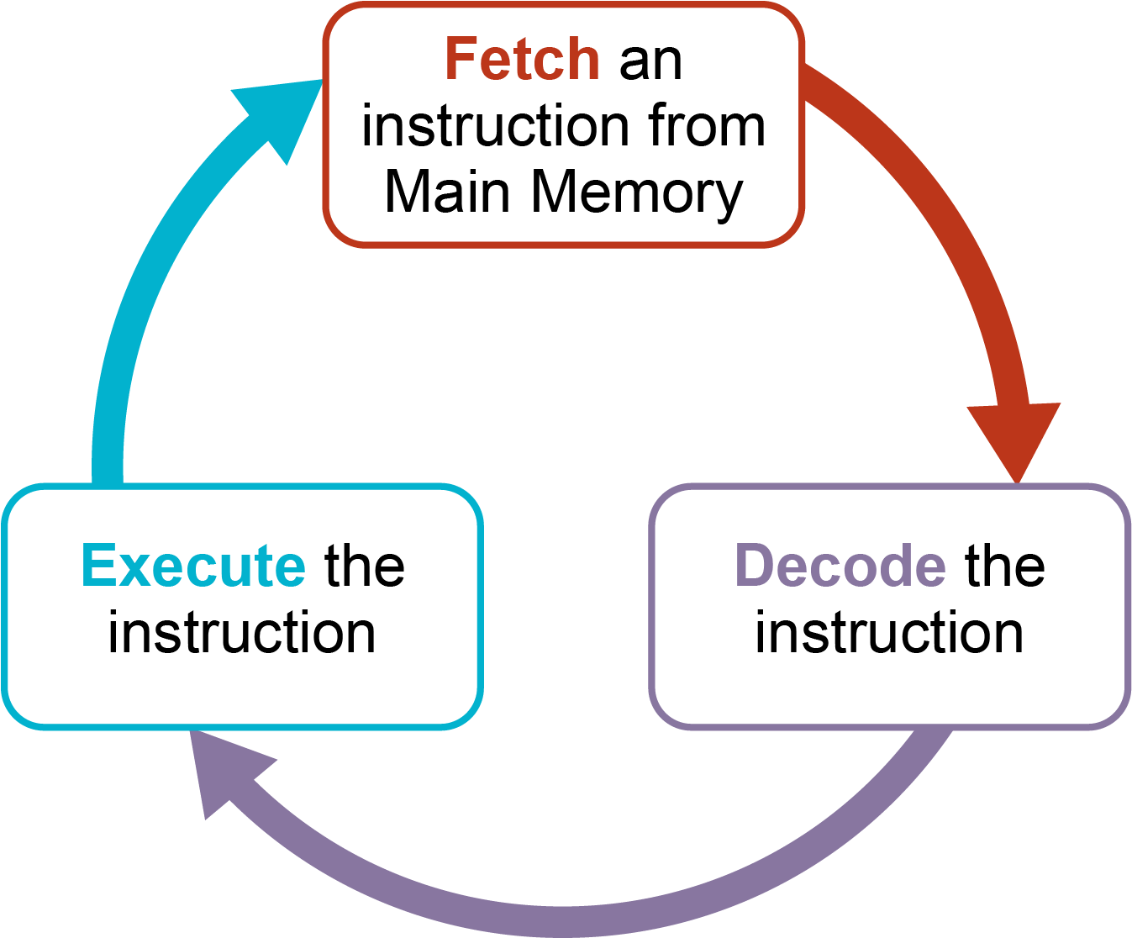
Fetch – Decode – Execute
The CPU operates by repeating three operations:
FETCH – causes the next instruction and any data involved to be fetched from main memory
DECODE – decodes the instruction
EXECUTE – the instruction is executed
This process is then repeated…

Slide 17
Program Counter (PC)
1
2
3
4
5 | LDA 10
6 | ADD 11
7 | STO 12
8
9
10 | 50
11 | 17
12
The Program Counter holds the address of the next instruction to be executed
The Program Counter is incremented (increased by 1) as soon as that instruction has been fetched
Program Counter
5

Slide 18
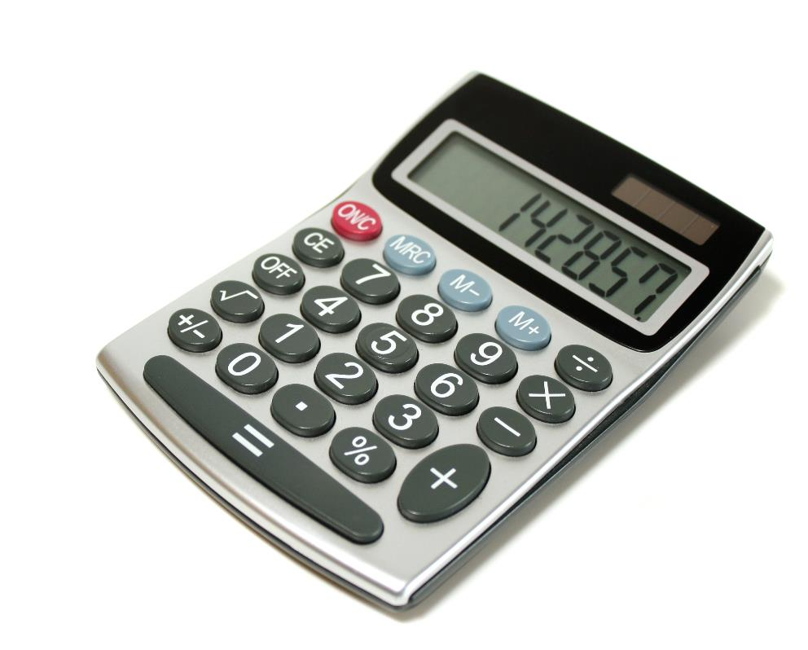
Accumulator
The accumulator (ACC) is where arithmetic and logic results are temporarily stored, much like the M+ function on a calculator

Slide 19
MAR and MDR
In the FETCH stage of the F-E cycle
the address of the instruction to be executed is copied from the Program Counter (PC) to the Memory Address Register (MAR)
The instruction at that address is fetched from memory and copied to the Memory Data Register (MDR)
The Control Unit decodes the instruction and decides if data needs to be fetched
If so, the MAR is then used to hold the address of the data to be used in the instruction
The data is fetched and copied to the MDR

Slide 20
Working together
MAR (Memory Address Register)
MDR (Memory Data Register)
The two work together; The MAR knows where to look for data in RAM, the MDR keeps hold of that data until it’s ready to be used by the CPU
MAR (Memory Address Register)
MDR (Memory Data Register)

Slide 21
Current instruction register (CIR)
The current instruction register holds the instruction that is being executed or decoded at the moment
It is also known as the instruction register (IR), but the name current instruction register gives you a clue that it is the instruction that is ‘currently’ being executed that it holds
Once the instruction is loaded from memory it is stored in the current instruction register (CIR)
Once the instruction is in the CIR it is decoded
If data is needed that is stored in memory it will be retrieved

Slide 22
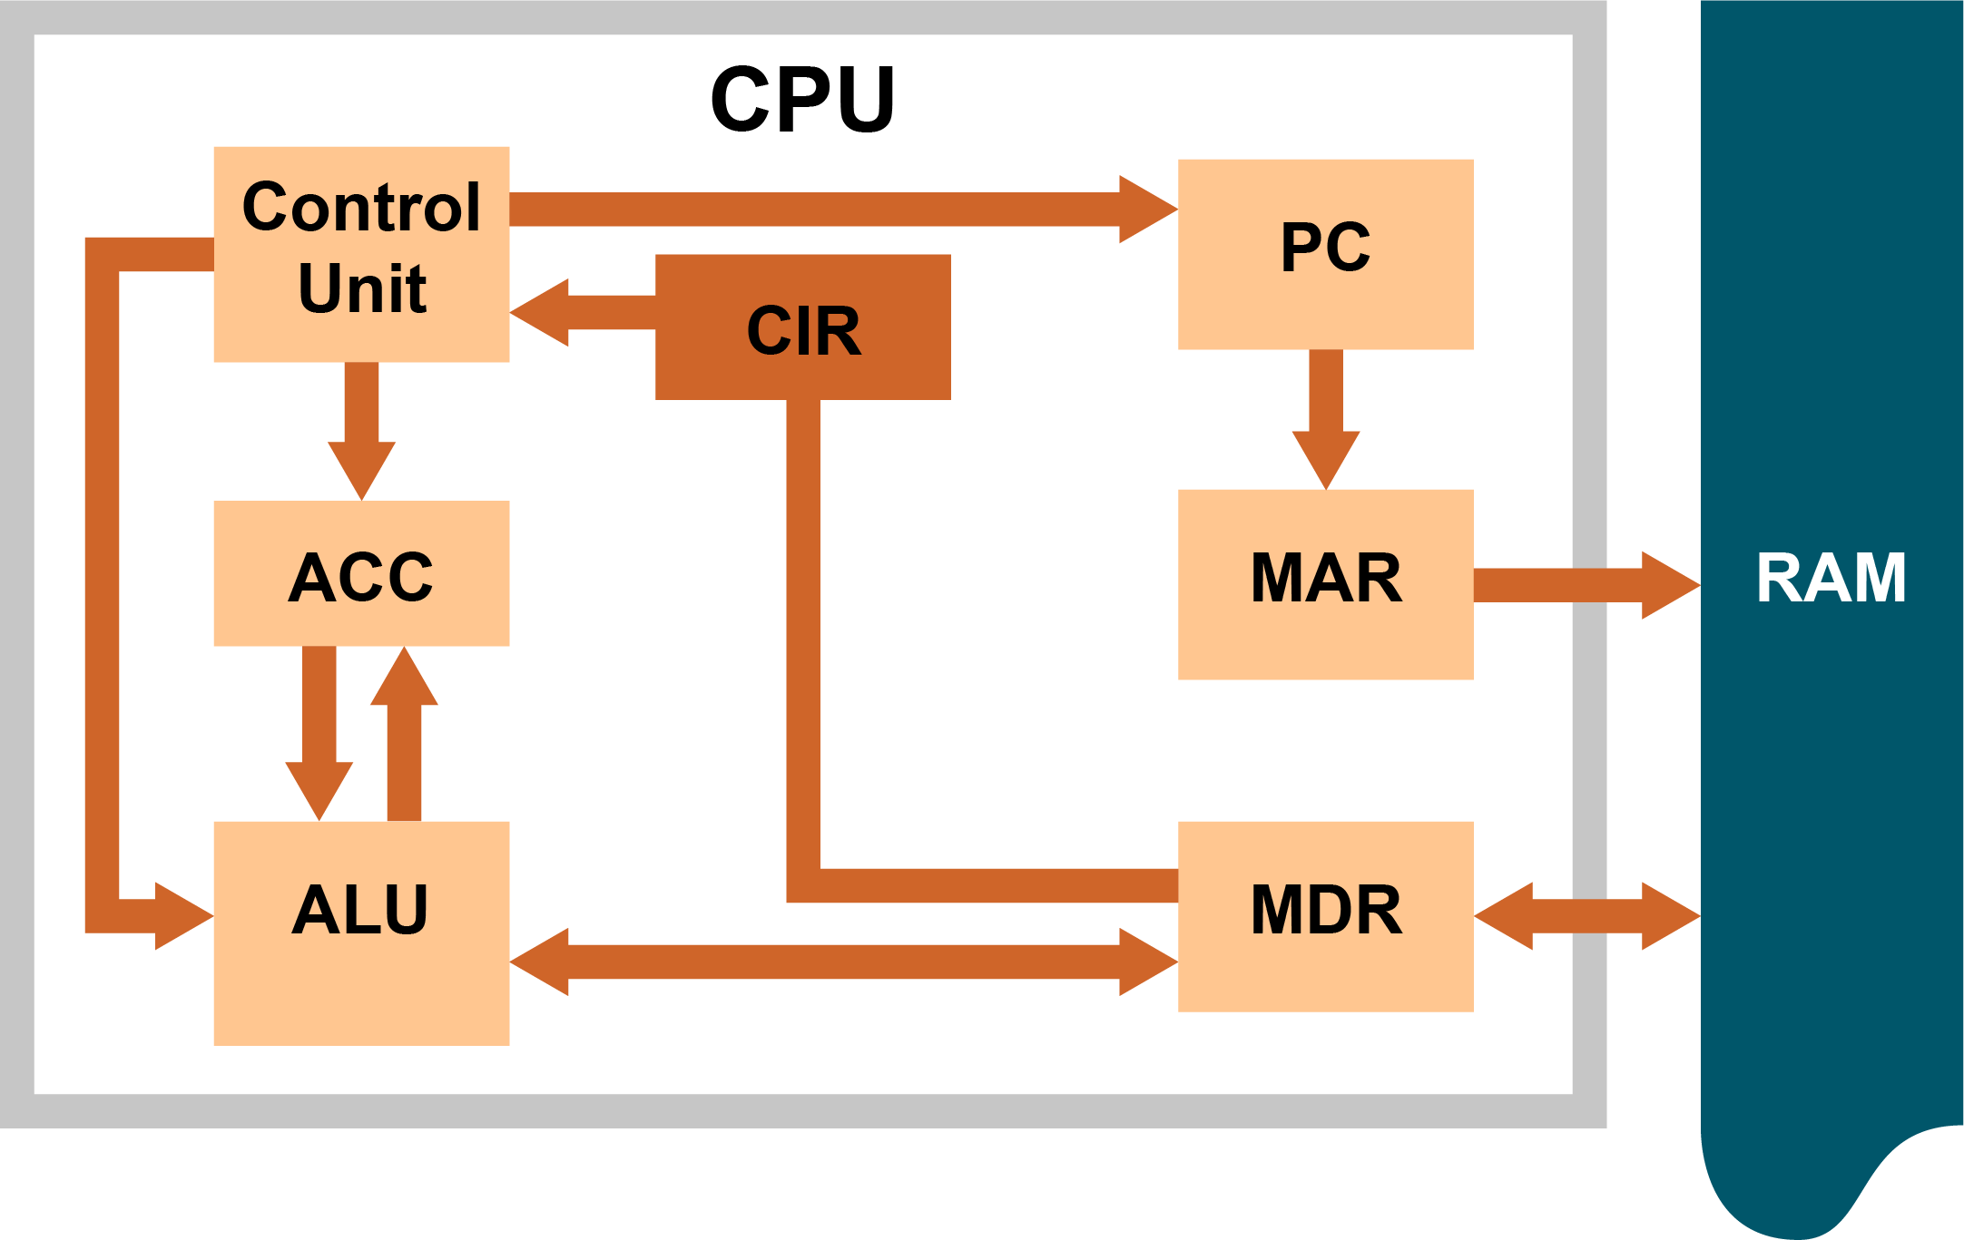
Processor architecture
What does each acronym stand for?
What does each part do?

Slide 23
Processor architecture
PC: Program Counter – points to the next instruction
MAR: Memory Address Register – stores the address of the instruction to be executed
ACC: Accumulator – Temporarily stores arithmetic results
RAM: Random Access Memory
ALU: Arithmetic Logic Unit – performs calculations and logic expressions
CIR:
Stores the current instruction to be decoded and executed
MDR: Memory data register – Stores the data to be sent/received from memory

Slide 24
Example – Step 1 (Add 8 + 4)
1
2
3
4
5 | LDA 10
6 | ADD #4
7 | STO 11
8
9
10 | 8
11
12
PC points to next instruction in location 5
Address 5 is passed to MAR and PC is incremented. It now holds 6
Instruction at Address 5 is copied from memory to MDR
Instruction passes to the CIR where it is decoded by control unit
Address 10 passed to the MAR
The value in location 10, i.e. 8, is passed from main memory to the MDR
8 is loaded into the accumulator (ACC)
Program Counter
5
Acc
8

Slide 25
Example – Step 2
1
2
3
4
5 | LDA 10
6 | ADD #4
7 | STO 11
8
9
10 | 8
11
12
PC now points to next instruction in location 6
Address 6 is passed to the MAR and the PC is incremented
Instruction at Address 6 passed to MDR
The instruction is passed to the CIR and then decoded
No more data from memory is needed
4 is added to 8 in the ALU and the result is stored in the accumulator (ACC)
Program Counter
6
Acc
12

Slide 26
Example – Step 3
1
2
3
4
5 | LDA 10
6 | ADD #4
7 | STO 11
8
9
10 | 8
11 | 12
12
PC points to the next instruction in location 7
Address 7 is passed to the MAR and the PC is incremented
Instruction at Address 7 passed to MDR
The instruction is passed to the CIR to be decoded
The instruction is executed causing the value 12 to be transferred from the accumulator into memory location 11
Program Counter
7
Acc
12

Slide 27
Worksheet 1
Complete Task 2 on Worksheet 1

Slide 28
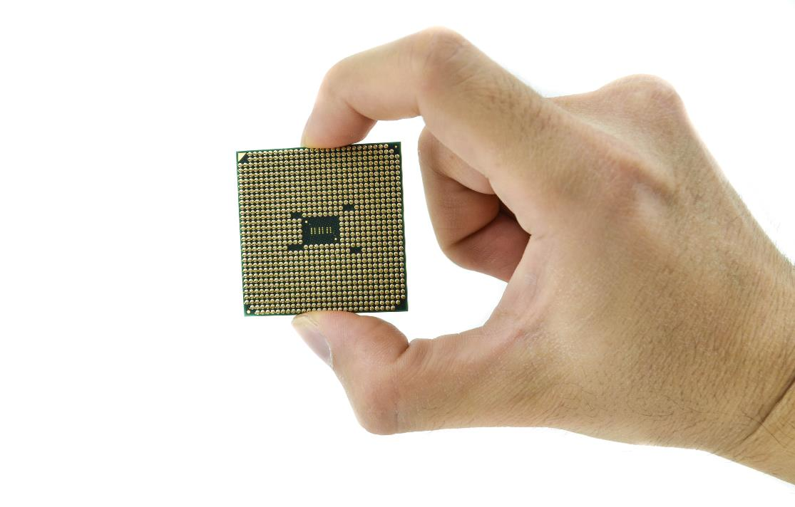
Plenary
In pairs, answer the following:
What is the purpose of the CPU?
What are two major components of the CPU, and what is the purpose of each?
What is a register?
Name four special registers in the CPU

Slide 29
Plenary
What is the purpose of the CPU?
To fetch and execute instructions stored in memory
What are two major components of the CPU, and what is the purpose of each?
The ALU, which carries out arithmetic and logic instructions
The Control Unit, which coordinates the CPU activities
What is a register?
A special fast memory location in the CPU
Name four special registers in the CPU
PC, MAR, MDR, CIR, Accumulator (ACC)

